Slide 1
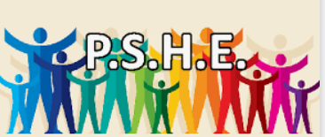







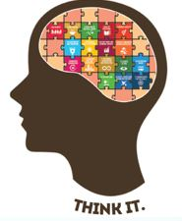


PSHE Knowledge Organiser
What would a peaceful community look like?
KS1
Term Autumn 2
  WE ARE ALL PEOPLE, WE ARE ALL THE SAME.
  Race – grouping of people together based on their
  visual features, most commonly skin colour.
  Racism – when someone treats a person or a group of people unfairly or
  thinks that they are inferior because of the colour of their skin or “race”
  Anti-racism – an ongoing active effort to challenge racism in society.
  Stereotype – An idea or belief many (not all) people have about a thing
  or a group that is often based upon how they look on the outside and is
  often untrue.
  Bias – means guessing something about someone else for no good reason.
  Discrimination – being unkind to someone because of what they look like or something else that they didn’t choose (gender, disability, family, skin colour
  and many more).
  Why is racism so bad?
  It hurts feelings – makes people feel sad, lonely and confused.
  It is unfair – people can’t do anything about who they are.
  We should feel proud of what makes us different, unique and special.
  How can we challenge racism?
  Say ‘that’s not right’
  Speak up calmly and respectfully (even though we may feel sad or angry)
  Make sure people know that we are an anti-racist.
  Key Points:
  We must treat everyone fairly and kindly, no matter what they look like.
  Don’t judge someone based on how they look.
  You can’t tell what someone’s personality will be like by looking at them.
  Being biased can cause lots of problems.
  How can we stop racism at our school?
  Be kind to everyone.
  Tell an adult
  Include everyone when you play.
Vocabulary Tier 3
Empathy
Respect
Judgement
Inferior
Vocabulary Tier 2
Race Racism
Anti-racism Stereotype
Bias Discrimination

