Slide 1
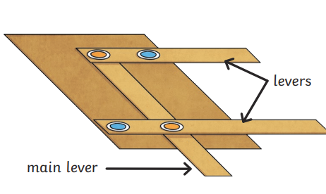
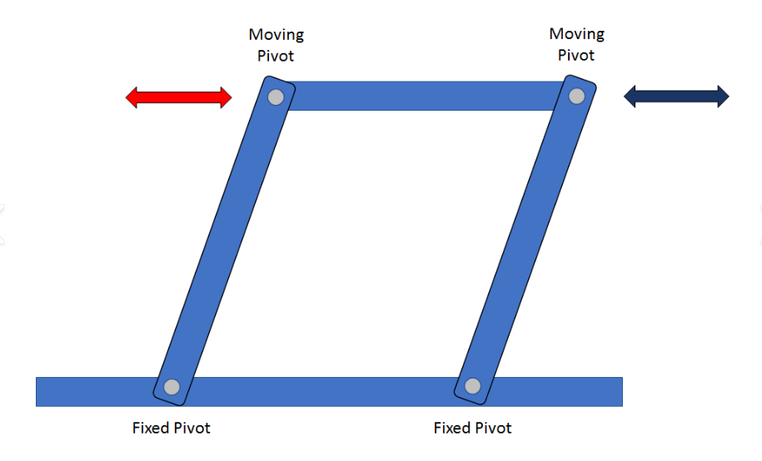
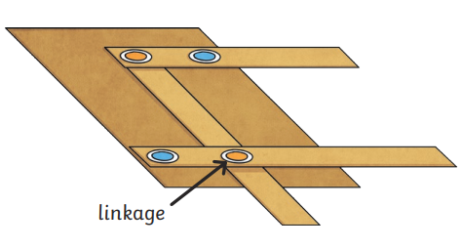
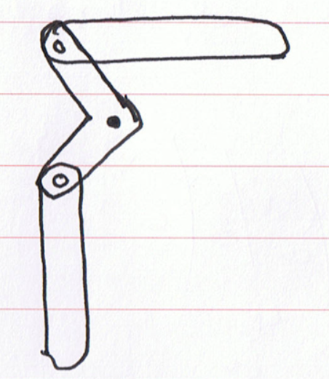
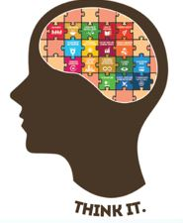
Design & Technology
Knowledge Organiser Is clean water always accessible?
Year 4
Term Spring_1
Levers
Choices of colour and the relationship between colours can influence how a piece of art looks, feel and the emotions it provokes.
Linkages
The part of a mechanism used to join one or more levers to produce the type of movement required.
Generate ideas
To explore different products and think about how they could be adapted.
Create an idea, annotate sketches of your idea and think how these can be edited and improved.
Planning stages
Design Brief
A planning document that explains what the project is, how it will be achieved and the time frame that it needs to be made in.
Design criteria
Tells you what a product must do to be successful.
Prototype
The first example of what the real thing will look like. This can be used with your generated ideas to test, develop, improve and evaluate your product.
Evaluation
Checking that the product made meets the design criteria and has achieved its purpose.
Vocabulary Tier 2
Movement
Design
Ideas
Plan
Motion
Product
Vocabulary Tier 3
Mechanism
Fulcrum
Pivot
Rotary
Linear
Design brief

