Slide 1
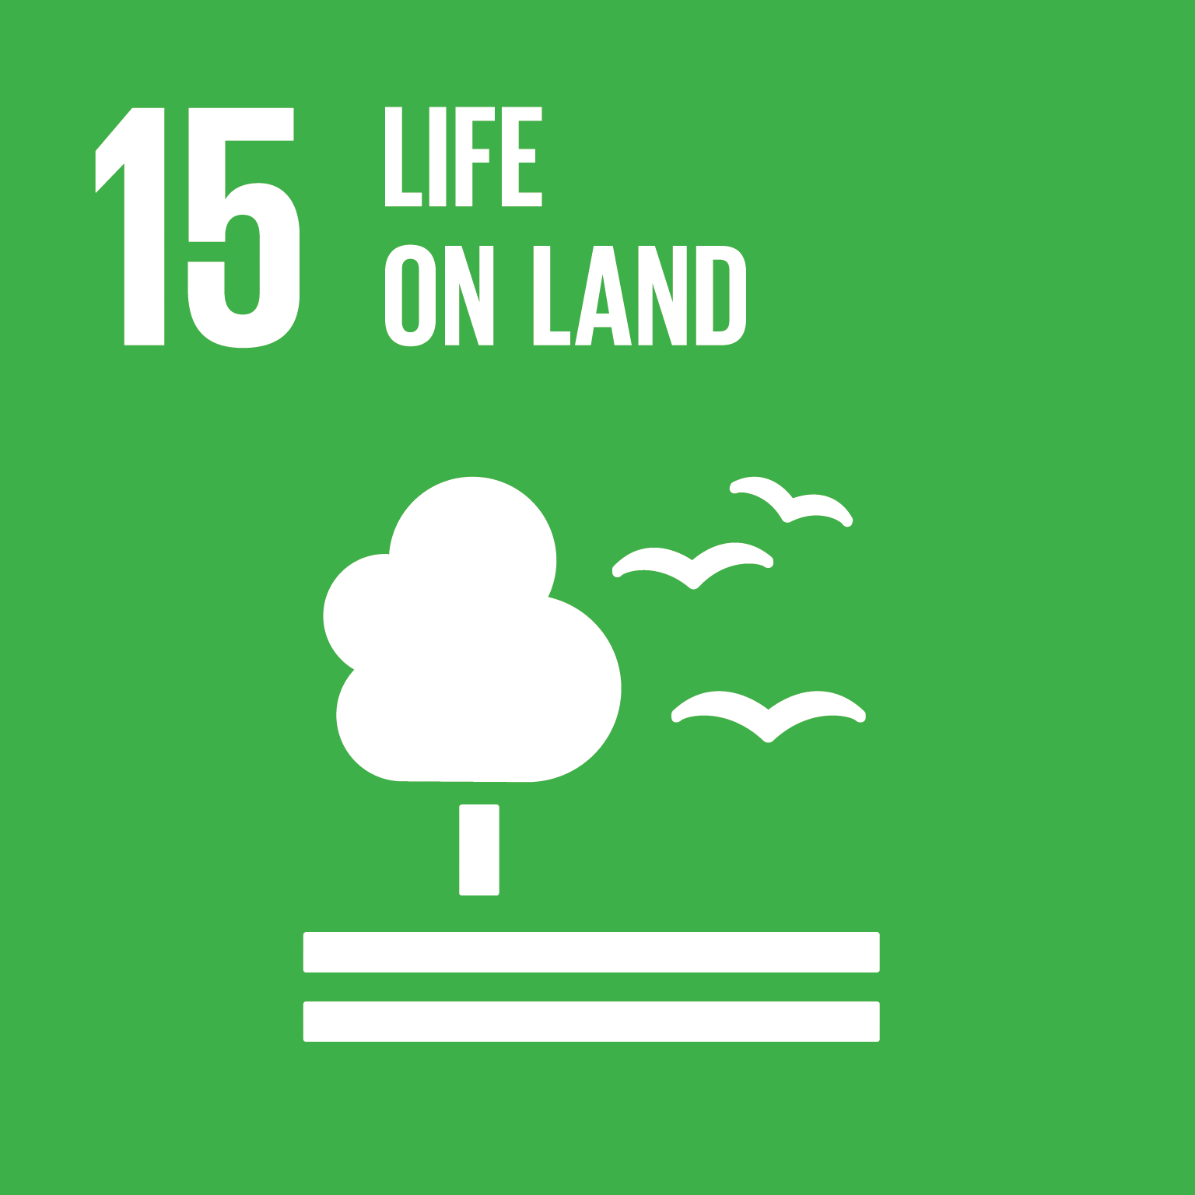
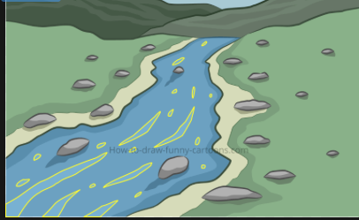
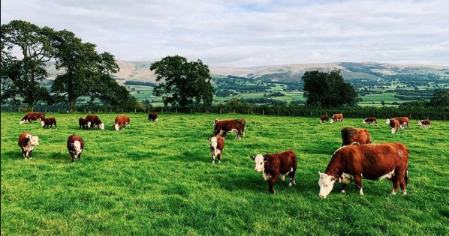
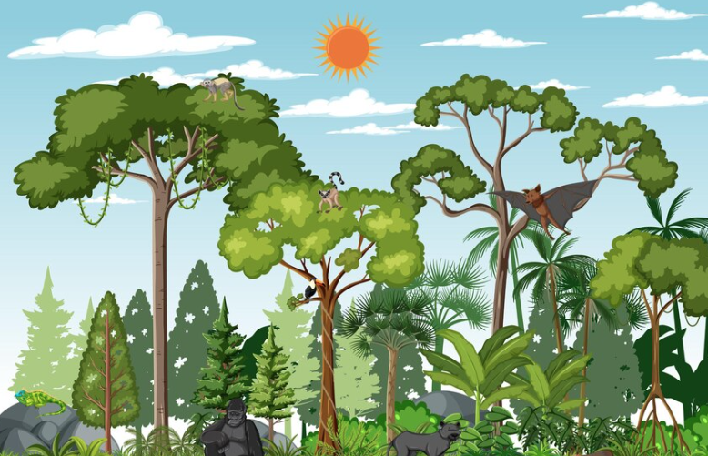
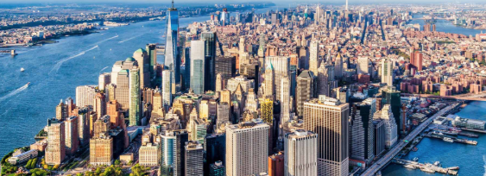
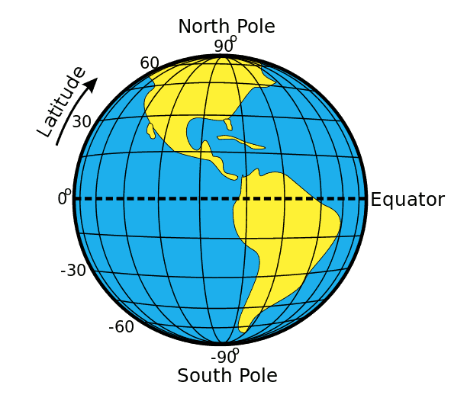
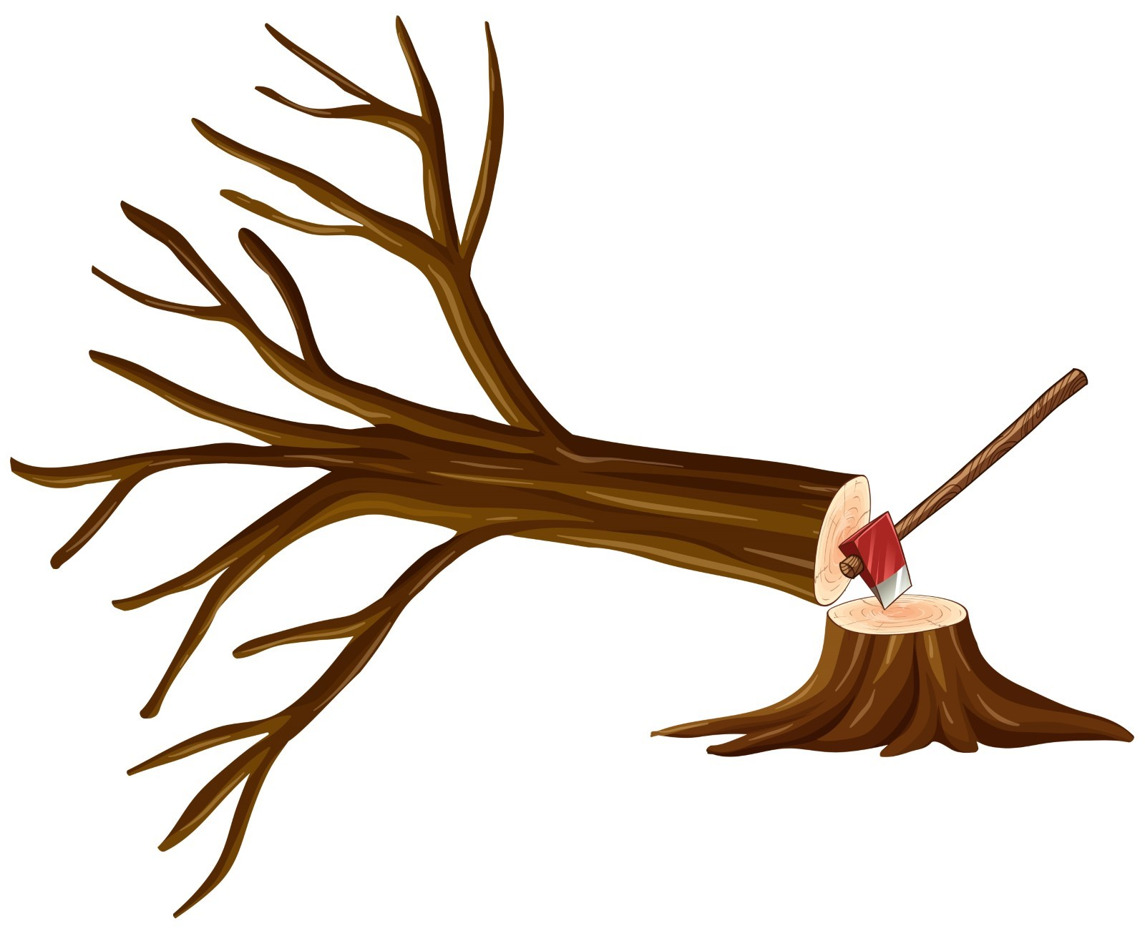
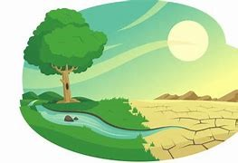
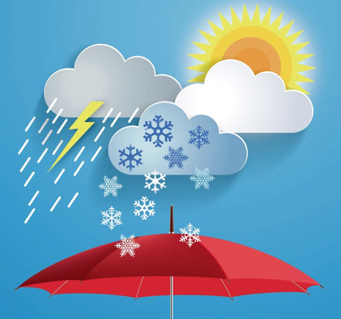
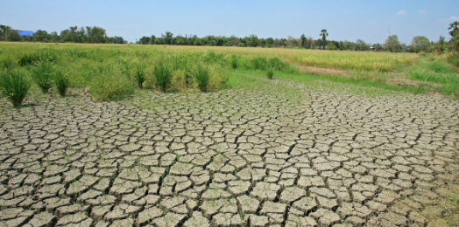
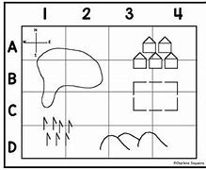
Year 4
Knowledge Organiser Environment and Biodiversity
Term Autumn_1
Landscape Features:
Human features
Human features are built. These include schools, buildings, roads, bridges and places of worship.
Physical features
Physical features are natural. These include rivers, hills, mountains and woodland.
Physical features – naturally occurring features, seas, mountains, rivers
Human features – features built by humans.
Rivers – natural freshwater source flowing to ocean, sea, lake or other river
Farming – uses value land and can need to land degradation
Rainforest – Earth's oldest living ecosystems. Habitat to the wildlife and vegetation
Urban areas reduce the habitat for wildlife and creates pollution.
Human activities have an impact on planet Earth
Locating areas in the world
Equator – the invisible line that runs around the centre of the Earth at 0 degrees latitude
Deforestation – the cutting down of a large area of trees
Desertification – desert expands affecting animals and environment.
Weather – changes over a short amount of time. Climate over a long term
Degradation – reduction of productive land
Map reading – 4 grid reference
Vocabulary Tier 2
Impact
Climate change
Biodiversity
Continents
Rainforest
Vocabulary Tier 3
Aerial
Habitat
Savannah

