Slide 1
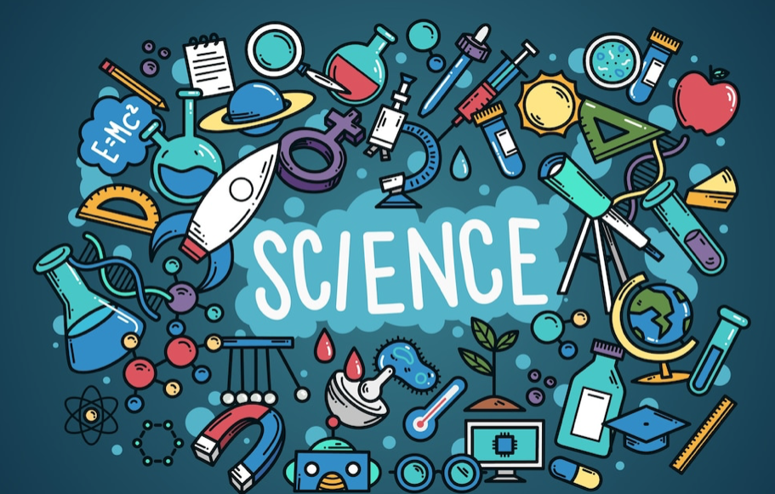
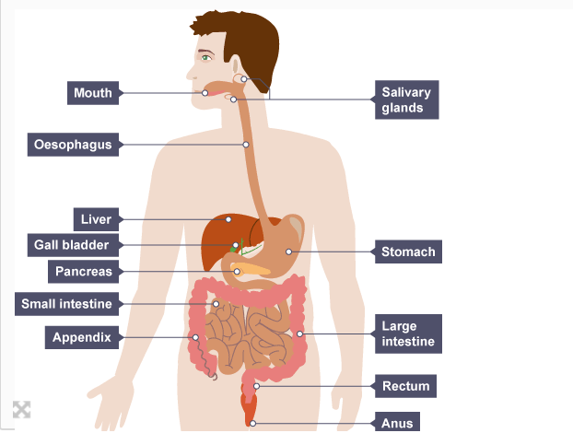
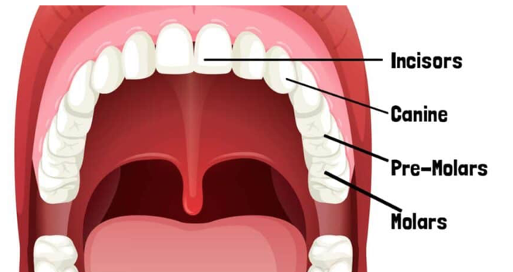
Year 4
Science Knowledge Organiser Animals including humans
Term Autumn_2
What do we already know…To make systematic and careful observations
Carnivores, herbivore and omnivores. The basic needs of animals . To make systematic and careful observations to animals including humans. The importance of different types of food and hygiene.
What are going to learn…
The digestive system in animals including humans.
The importance of our teeth and their different functions and how to look after them.
The food chain.
Digestive system
Mouth – where food and liquids enter
Salivary gland – produce saliva to start to break down the food
Teeth – chew and grind the food
Oesophagus – swallowed food is taken from the mouth to the stomach
Stomach – where the food is broken down further
Small intestines – where most of the food is broken down. Nutrients are absorbedinto the blood
Large intestines – Water is removed from the food for the body to use.
Rectum – The remains of the food is stored here
Digestion system is a group of organs that help the bod to turn food and liquids into building block and fuel that the body needs.
Teeth
Human beings have 2 sets of teeth. Milk teeth and adult teeth
Incisors – cut and tear food
Canines – grip, rip and tear food
Pre-molars and Molars – chew and grind food
Human teeth can decay if sugars in the food turn into acid which turns into plaque. Brushing twice a day and visits to the dentist help to maintain healthy teeth
Food Chain – how energy is passed from the sun to plant to animals and even humans.
Sun --> Producer-->Primary consumer ---> Secondary consumer-> Tertiary consumer

