Slide 1
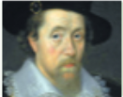
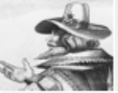
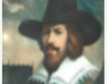
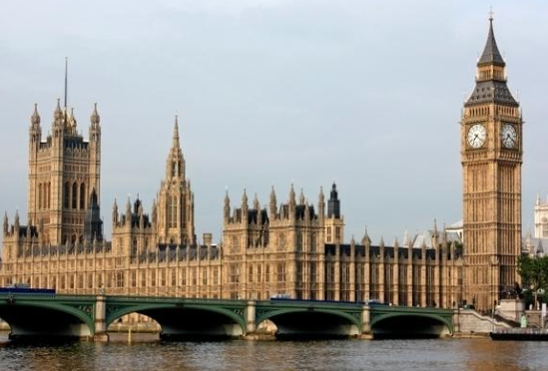
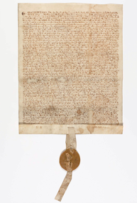
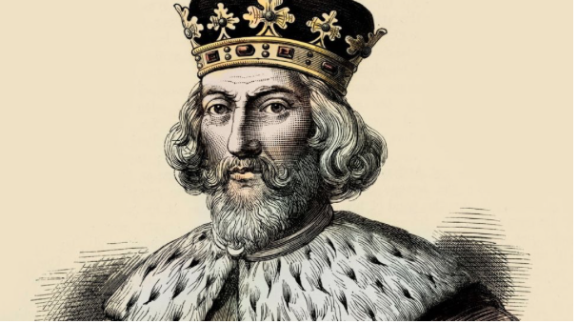
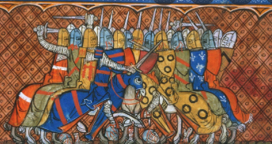
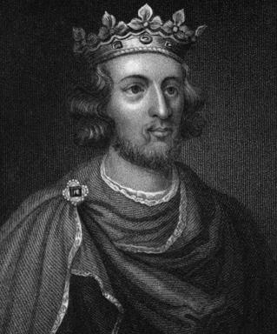
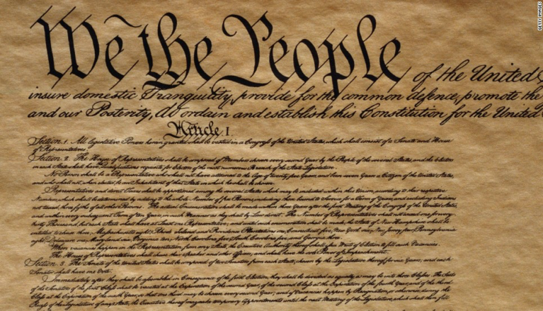
Year 4
History Knowledge Organiser Gunpowder plot and the Magna Carta
Term Autumn_2
What do we already know…
We know about some people experience inequalities if they come from different backgrounds during the Victorian era within workhouses, during the Ancient Greeks and on the Titanic.
What are going to learn…
What happens if enough people feel strongly about inequalities and how they can make a change.
How some changes still have an impact on our society today.
Gunpowder plot 5th November 1605
The Gunpowder plot was an attempt made by a group of Catholics to blow up the King James I and the the Houses of Parliament.
Key people and places
James 1 (James VI) – King of Scotland and then England. Cousin of Queen Elizabeth I.
Robert Catesby – The Catholic leader of the group plotting to blow up the House of Parliament.
Guy Fawkes – A conspirator who was found with fuses and matches and arrested.
The House of Parliament – The place where laws are made and passed in the United Kingdom.
Vocabulary
Catholics – A group of Christians who believe in Jesus and are led by the Pope and have elaborate Church masses.
Protestant – A group of Christians who think that the Bible is important and have simple Church services.
Plot – A secret plan to do something against the law
Treason – The act of plotting or carrying out a crime against the monarch
Gunpowder – A chemical, invented by the Ancient Chinese, that explodes if lit by fire.
Conspirator – A person who plots with others to do something harmful or unlawful.
Magna Carta 1215
Magna Carter means the Great Treaty or Charter in Latin. It was written to ensure that everyone obeyed the basic rules, even the King.
Key people and places
King John – a very unpopular king who did not follow any laws and made the people very unhappy.
Barons – people who owed land and worked for the King
Henry III
US Constitution – the fundamental laws of USA - 1787
Universal Declaration of Human Rights 1948 translated to 500 languages
Vocabulary
Laws – system of rules in a country
subjects - ruled by a monarch or ruler
monarch – sovereign head of state, King or Queen
tax – compulsory contribution given to the ruler or government
liberty – being free in society
justice – laws are used to ensure fairness in all circumstances
rights – laws that protect people and what they are allowed to do.
Rebellion – open disagreement with ruler, leader or government

