Slide 1
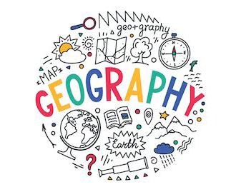
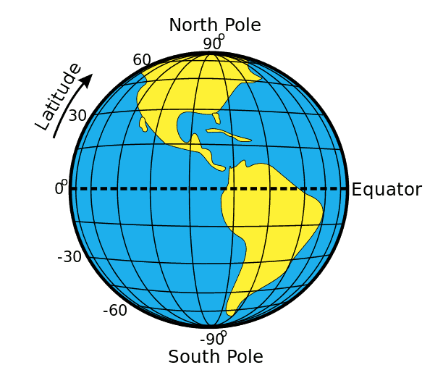
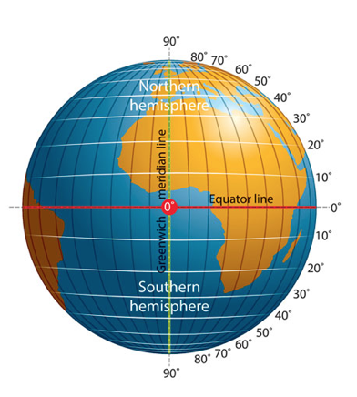
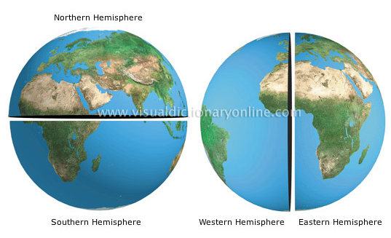
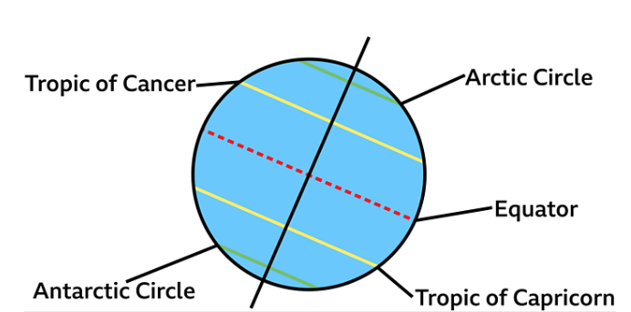
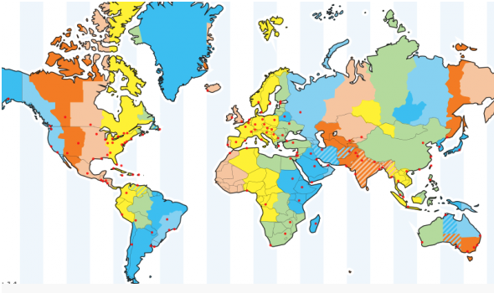
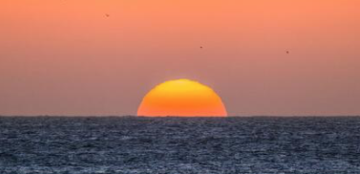
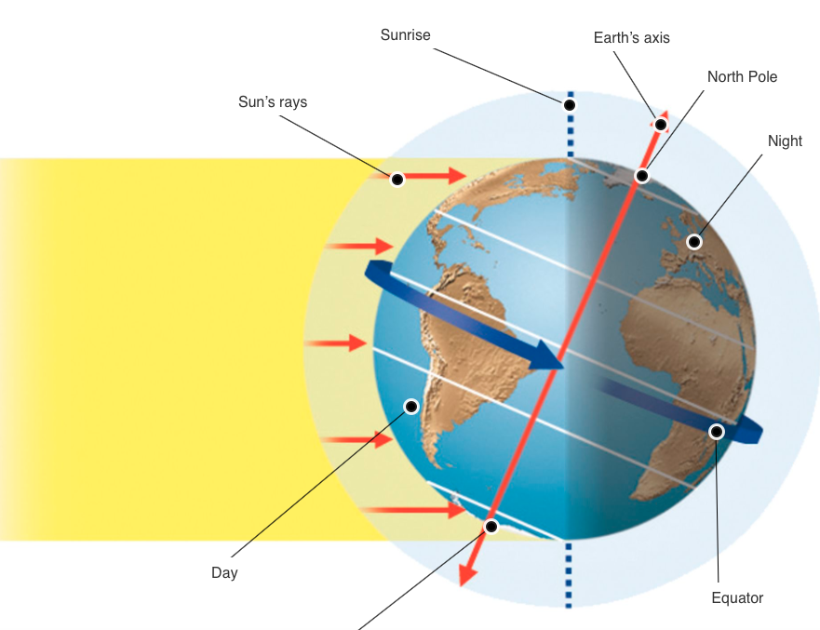
Da
Year 4
Geography Knowledge Organiser Lines of latitude and longitude
Term Autumn_2
Lines of latitude and longitude – they are imaginary lines to help locate where places are in the world. They are also vital to navigation.
Vocabulary
Latitude | Imaginary lines that run West to East around the world. They are parallel to the Equator
Longitude | Imaginary lines that run North to South from North pole to South pole
Equator | The invisible line that runs around the centre of the Earth at 0 degrees latitude
Poles | North Pole – Arctic Circle 66.5°N South Pole – Antarctic Circle – 66.5°S
Degree | The measurement used for latitude and longitude, e.g., 66.5°S
Hemisphere | Hemi means half. Half of the earth that divided by the Equator. North and South hemisphere
Tropics | Where there are no seasons – hot and humid all year round. Tropic of Cancer – the most northern point where the sun is directly overhead at midday. It is 23.5°N of the Equator Tropic of Capricorn – the most southern point where the sun is directly overhead at midday. It is 23.5°S of the Equator.
Axis | An imaginary line that the Earth rotates around
Time zone | Parts of the world that have the same time at any particular point in the day.
Horizon | The line where the earth's surface and sky appear to meet.
Day and Night | Day time – parts of Earth that have rotated to face the Sun. Night time – parts of Earth that have rotated away from the Sun towards space.

