Slide 1
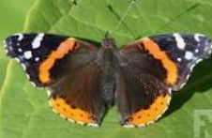


2024 Cohort Welcome meeting
Monarch and Admiral classes

Slide 2
How will learning look at Buckden school?
Continuation of what have been doing in preschool and nursery settings. Working on Development Matters then 17 ELG’s which are reported on at end of year as emerging, expected. 3 prime areas PSED, C&L, PD, 4 specific Literacy, Maths, Ex Arts and Design and Understanding World. Will still be play based.
Baseline assessment- Government baseline will be completed in first weeks along with own baseline through conversations with parents, settings and our observations.
Observations and playing with children and asking questions, getting to know them individually.
Class unit structure- 2 classes separate for the mornings but join for the afternoons. Will be swaps until balance/ needs are best met.
‘Success for All’ phonics begins from Week 2. A parents’ session specifically on this will take place in September.

Slide 3
How will learning look at Buckden school?
Importance of reading- short, daily home reading makes so much difference to a child’s success and enjoyment of reading. We use the app Boom Reader. Log on information will be sent home with your child in the second week.
Home/School agreement- daily reading with your child is mandatory not optional as it directly impacts their future success in all learning areas.
Talk homework to help prepare your child for next weeks learning, expanding their vocabulary around the topic.
Funky finger activities, dough disco and circuits to strengthen muscles needed for writing. Move onto pencil control and patterns then letter formation.
Maths-Follow NCETM mastering number and White Rose which focuses upon developing a firm foundation of numbers 0-10 including subtising, composition, comparison and pattern in number. A parent meeting will be scheduled to share more about this in October.
Topic based half termly themes linked to global learning goals and including history, geography, science, art, DT, music, French and RE.

Slide 4
How will learning look at Buckden school?
Mind Up Mental Health Brain Breaks
French
Nature schools, local visits and having visitors in.
Skills builder projects- listening, leadership, creativity, presenting
problem solving, team work, aiming high, staying positive.
Oracy- Three minute talk. Your child will be given a day to bring in something linked to our topic to share and discuss. The timetable will be sent in the first week of each half term.

Slide 5
Working together
Parents’ evenings
Termly progress and learning behaviour reports
End of year report based upon Early Learning Goals and Characteristics of Effective Learning
Email via- eyfs@bpa.act-academytrust.org and we will respond as soon as possible.
Attendance- really important as learning in Reception happens at a fast pace and social impact of missed days.

Slide 6
Learning themes
Linked to the whole school Global Learning Curriculum
Autumn 1- Magical Me- Good Health and Wellbeing and Quality Education
Autumn 2- Celebrations- Reduced Inequalities
Spring 1- Once Upon a Time- No Poverty
Spring 2- Super Heroes- Peace and Justice
Summer 1- Down at the Bottom of the Garden- Life on Land, Climate Action, Responsible Consumption
Summer 2- Around the World in ?? Days- Sustainable Cities and Communities
Notes:
Give examples. Remain calm and positive. It will happen. Getting the environment right. Keep it fun.

Slide 7
Transition Plan- (
We have already been visiting your children in their settings or having conversations with their key people over the phone when this has not been possible.
Short visits into our school in the mornings of first week in July to get to know the space and one another.
Home visits for first time families in first week in July, telephone conversations with second time families.
Smaller group start during first week back to allow children to get used to the whole day routines, have a lunch and for us to administer the Government Baseline Assessment effectively.

Slide 8
Importance of regular reading
Key Findings from research around early childhood reading.
The frequency of reading to children at a young age has a direct causal effect on their schooling outcomes.
Reading to children at age 4-5 every day has a significant positive effect on their reading skills and cognitive skills (i.e., language and literacy, numeracy and cognition) later in life.
Reading to children 3-5 days per week (compared to 2 or less) has the same effect on the child’s reading skills at age 4-5 as being six months older.
Reading to them 6-7 days per week has the same effect as being almost 12 months older.
Children read to more frequently at age 4-5 achieve higher scores in national assessments
These differences in reading and cognitive skills are not related to the child’s family background or home environment but are the direct result of how frequently they have been read with.
Notes:
Whilst we do teach reading every day through phonics lessons with your children and hear your child read at least once a week, what we cannot do is offer the 1:1 daily reading needed for overlearning and embedding of reading skills over time.

Slide 9


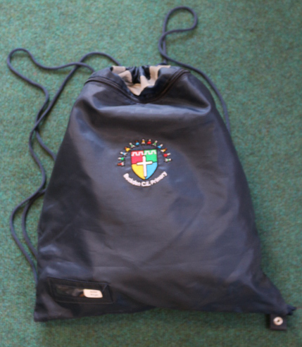





What your child will Need
I read, we read, you read

Slide 10
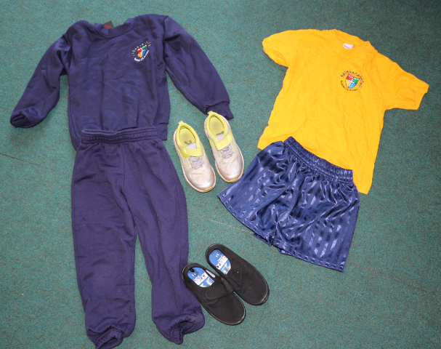
PE Kit
Indoor
Outdoor
Blue shorts
House t-shirt
Plimsolls
Socks
Blue trousers
Blue jumper
House t-shirt
Trainers
Socks
Girls hair must be tied back at all times using navy blue or white simple hair ties.

Slide 11
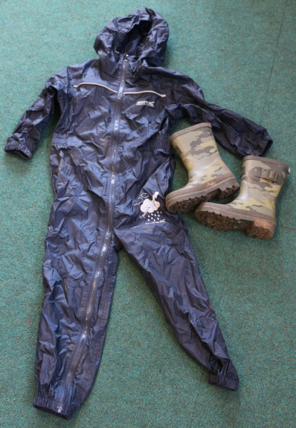
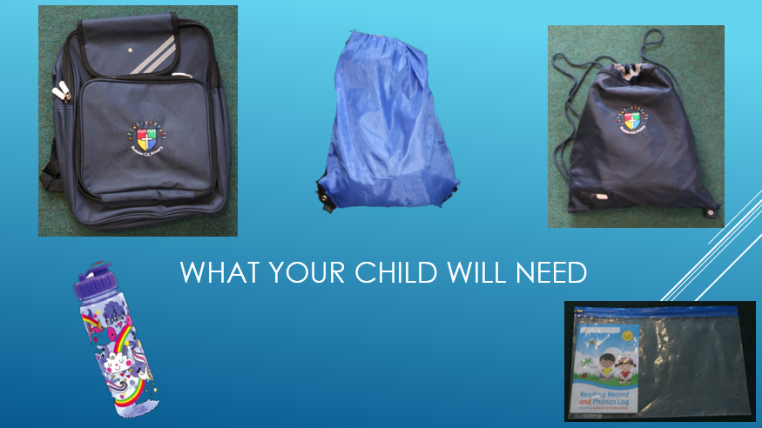
Wellie Bag
Wellies
Puddle suit

Slide 12




School Bag
Water Bottles- no juice, just water
Sunhat
Reading Folder

Slide 13
Reading Folder
Reading Books – Initially they wont have words,
start by talking about the pictures and see if
you can use story language.
I read- FFt Success for All phonics book- entirely decodable based upon phonics program and read
every day in school with teacher
We read- phonics decodable book but may have odd words your child may need help with.
You read- fiction of non fiction book to read to your child for pleasure.
Reading App– Boom reader Please complete this everyday when you read. Teacher will record reading
once a week.

Slide 14
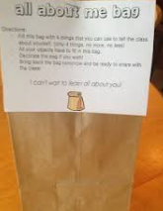
All about me bag
We will hand these out when your child comes for their transition visit during first week in July.
Fill with items that show your child’s interests, family, pets. Can be things, pictures or photos.
These are shared with whole class to see who shares interests and help establish friendships and are used
for your child to have a look at whenever they wish to. Nothing too precious as things will be looked at/
touched by others.

Slide 15
Other Things
School dinners- 3 colour choices- red=meat, green = vegetarian, yellow= fish or jacket potato. Please help your child to select each morning before school to so your child is prepared when we call the register.
Morning snack- fruit provided but can bring in an additional healthy snack- nut free. Example cheese and crackers, bread sticks, vegetables and dip
Whatsapp groups/ facebook groups. These are great to help organise get togethers over the summer or send reminders about events or things to bring in. Any other queries, questions or problems please use the eyfs@bpa.act-academytrust.org so we can respond directly, fully and promptly.
Parent volunteering- come in and hear readers, help with church walks, locality walks and excursions. People who help us visitors.
All about me bags- bring in in September please

Slide 16
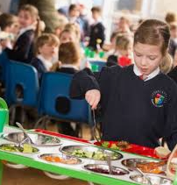

School dinners
Dietary needs can be catered for- Mrs Bigg will happily discuss this with families.

Slide 17
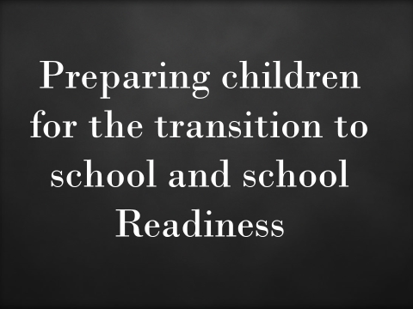

Slide 18
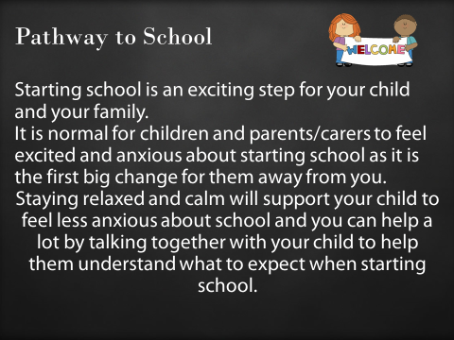

Slide 19
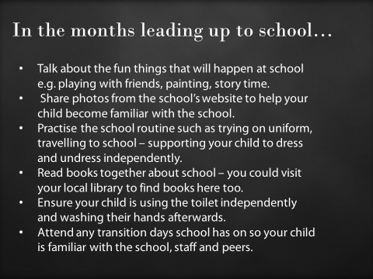

Slide 20
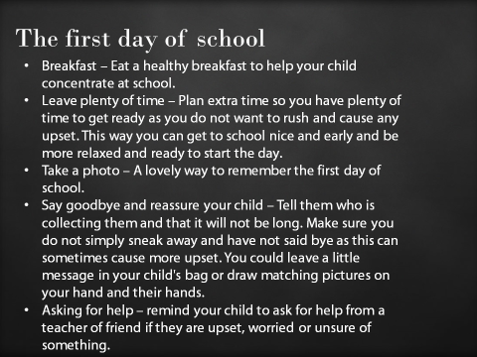

Slide 21
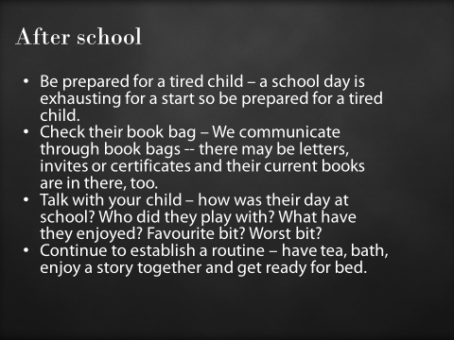

Slide 22
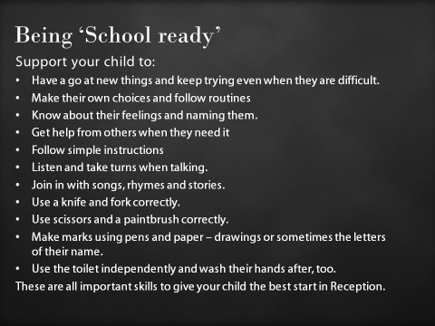

Slide 23
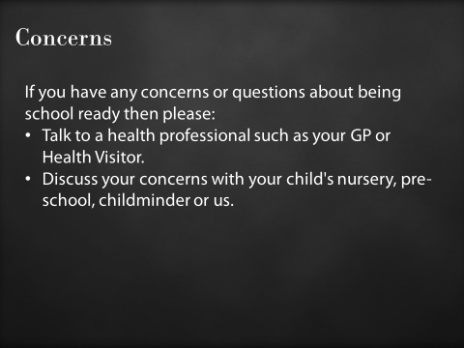

Slide 24

Home School Hub (HSH)

Slide 25

Liaise with external agencies and professionals to signpost parents towards help and support
To support children and families pastorally (anxiety, financial difficulties, mental health and wellbeing, Trauma)
Parent Liaison & communication through school parent communication monthly meetings
Regular Attendance in school
Establish Routines
Soft Start Provision supporting vulnerable children and families
Parent Education – curriculum workshops/behaviour support

Slide 26
Home School Hub (HSH)
Support from the HSH will be available weekdays during term time only.
Soft Start Provision starts at 8.15am every morning accessed through the HSH entrance.
HSH front door will be open for drop-in sessions from 8.45-9.15 and 3pm – 3.30pm Monday-Friday.
Attendance
Contacting the HSH – Email: PastoralSupport@buckdenacademy.org or
HSH@buckdenacademy.org
Tel: 01480 810241

Slide 27


Slide 28
All slides are available on the website:
www.buckdenschool.co.uk in
Early Years Foundation Stage
Class blogs are updated weekly on a Friday to share what we are doing.

