Slide 1
Notes:
Teacher Note - Please check that the content in this link/links, including any comments, is suitable for your educational environment before showing. Please do not let the next video automatically play at the end of the clip. Twinkl accepts no responsibility for the content of third party websites. This PowerPoint Presentation/resource contains links to external websites. Please check that the content of external links is appropriate for the intended audience. Twinkl Ltd is not responsible for the content of external links.

Slide 2
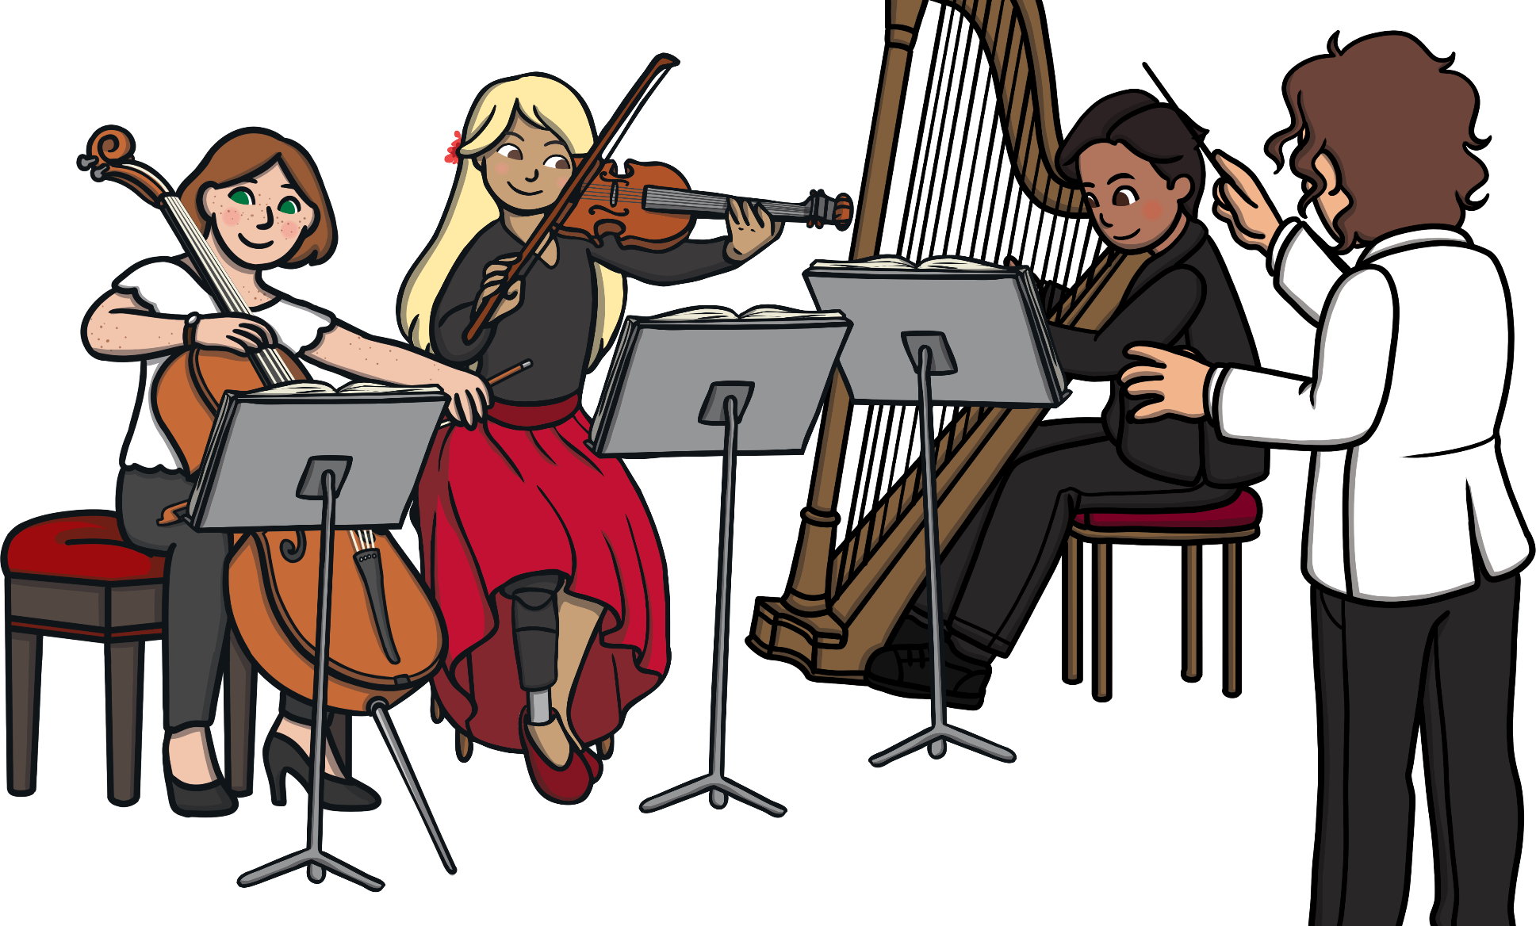
There are four instrument families in an orchestra.
percussion
strings
woodwind
brass

Slide 3
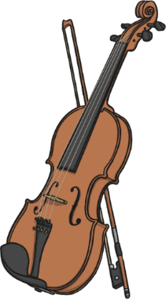
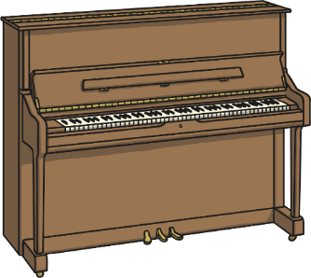
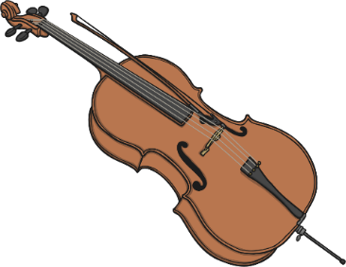
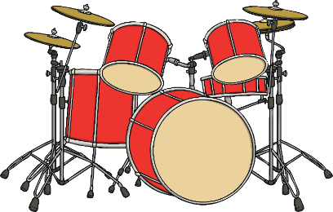
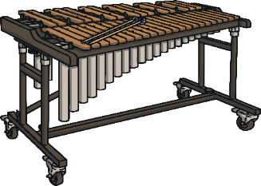
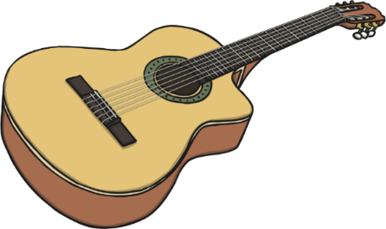
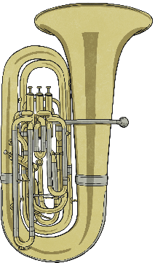
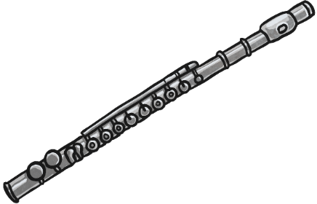
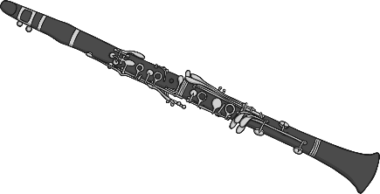
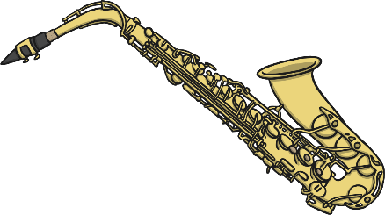
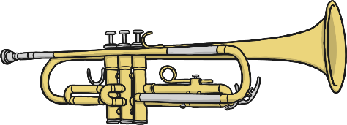
Click an instrument to watch a video:
piano
cello
violin
xylophone
drums
guitar
tuba
flute
trumpet
clarinet
saxophone
Notes:
Teacher Note - Please check that the content in this link/links, including any comments, is suitable for your educational environment before showing. Please do not let the next video automatically play at the end of the clip. Twinkl accepts no responsibility for the content of third party websites. This PowerPoint Presentation/resource contains links to external websites. Please check that the content of external links is appropriate for the intended audience. Twinkl Ltd is not responsible for the content of external links.

Slide 4
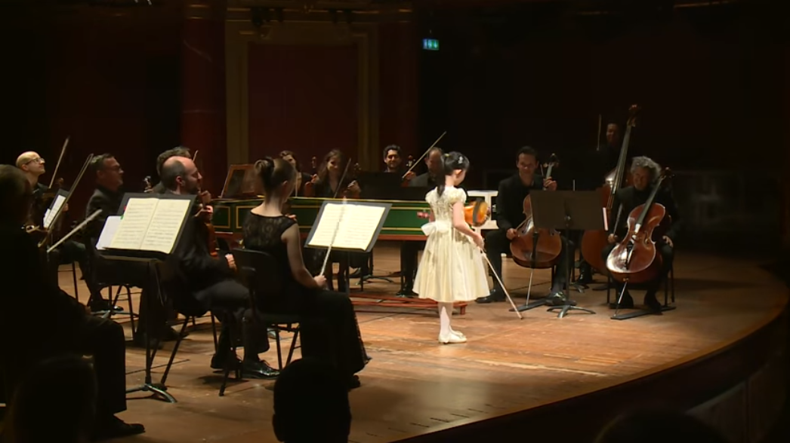
back
Notes:
Teacher Note - Please check that the content in this link/links, including any comments, is suitable for your educational environment before showing. Please do not let the next video automatically play at the end of the clip. Twinkl accepts no responsibility for the content of third party websites. This PowerPoint Presentation/resource contains links to external websites. Please check that the content of external links is appropriate for the intended audience. Twinkl Ltd is not responsible for the content of external links.

Slide 5
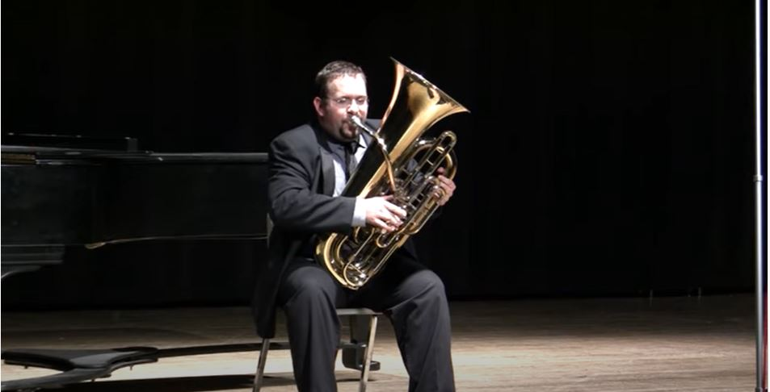
back
Notes:
Teacher Note - Please check that the content in this link/links, including any comments, is suitable for your educational environment before showing. Please do not let the next video automatically play at the end of the clip. Twinkl accepts no responsibility for the content of third party websites. This PowerPoint Presentation/resource contains links to external websites. Please check that the content of external links is appropriate for the intended audience. Twinkl Ltd is not responsible for the content of external links.

Slide 6
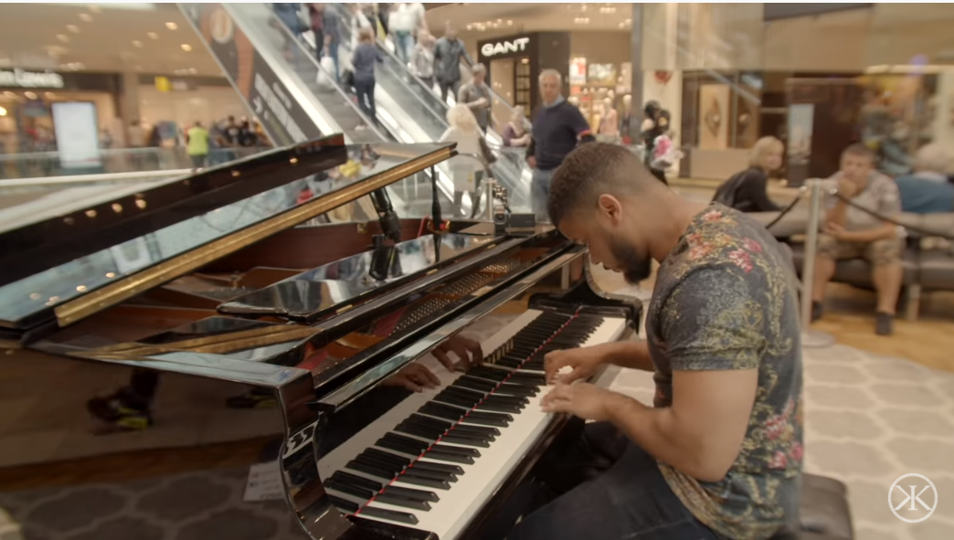
back
Notes:
Teacher Note - Please check that the content in this link/links, including any comments, is suitable for your educational environment before showing. Please do not let the next video automatically play at the end of the clip. Twinkl accepts no responsibility for the content of third party websites. This PowerPoint Presentation/resource contains links to external websites. Please check that the content of external links is appropriate for the intended audience. Twinkl Ltd is not responsible for the content of external links.

Slide 7
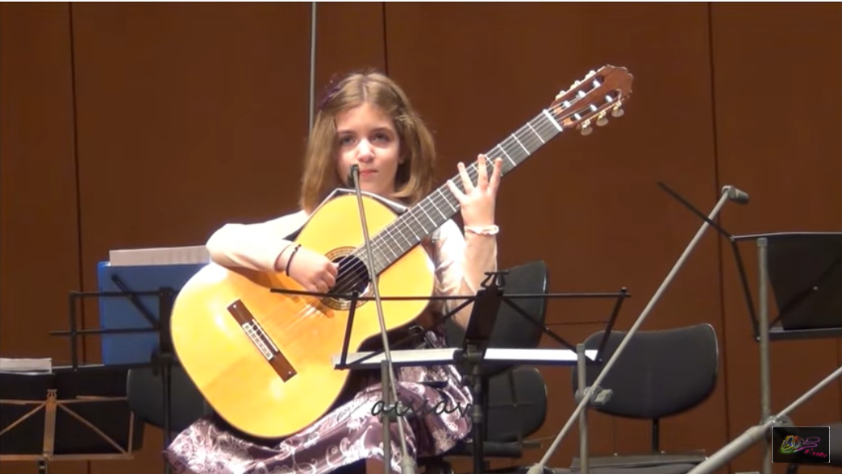
back
Notes:
Teacher Note - Please check that the content in this link/links, including any comments, is suitable for your educational environment before showing. Please do not let the next video automatically play at the end of the clip. Twinkl accepts no responsibility for the content of third party websites. This PowerPoint Presentation/resource contains links to external websites. Please check that the content of external links is appropriate for the intended audience. Twinkl Ltd is not responsible for the content of external links.

Slide 8
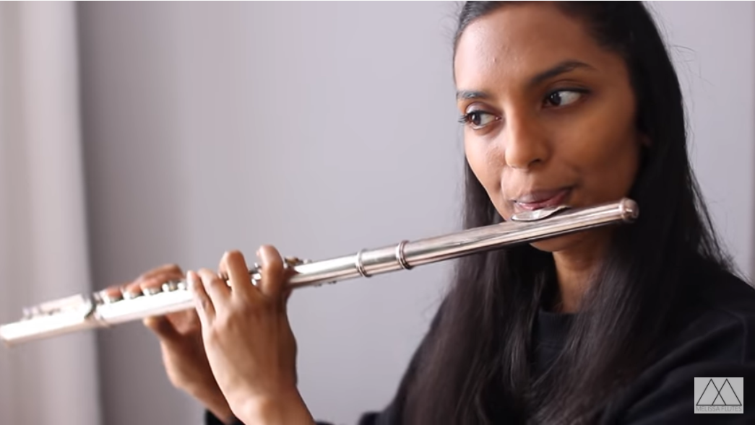
back
Notes:
Teacher Note - Please check that the content in this link/links, including any comments, is suitable for your educational environment before showing. Please do not let the next video automatically play at the end of the clip. Twinkl accepts no responsibility for the content of third party websites. This PowerPoint Presentation/resource contains links to external websites. Please check that the content of external links is appropriate for the intended audience. Twinkl Ltd is not responsible for the content of external links.

Slide 9
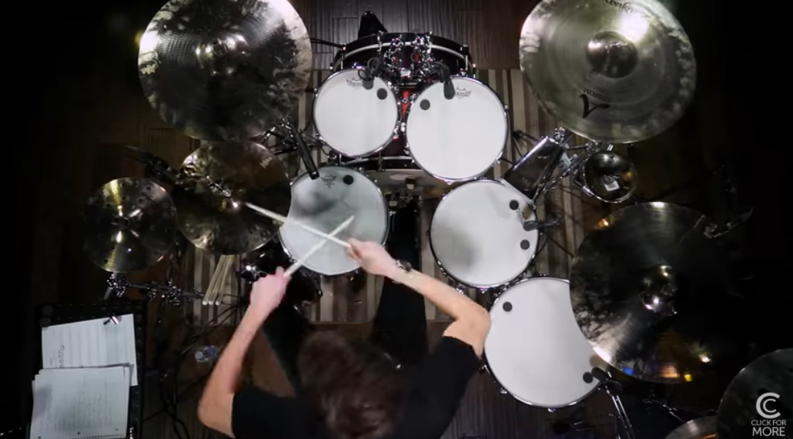
back
Notes:
Teacher Note - Please check that the content in this link/links, including any comments, is suitable for your educational environment before showing. Please do not let the next video automatically play at the end of the clip. Twinkl accepts no responsibility for the content of third party websites. This PowerPoint Presentation/resource contains links to external websites. Please check that the content of external links is appropriate for the intended audience. Twinkl Ltd is not responsible for the content of external links.

Slide 10
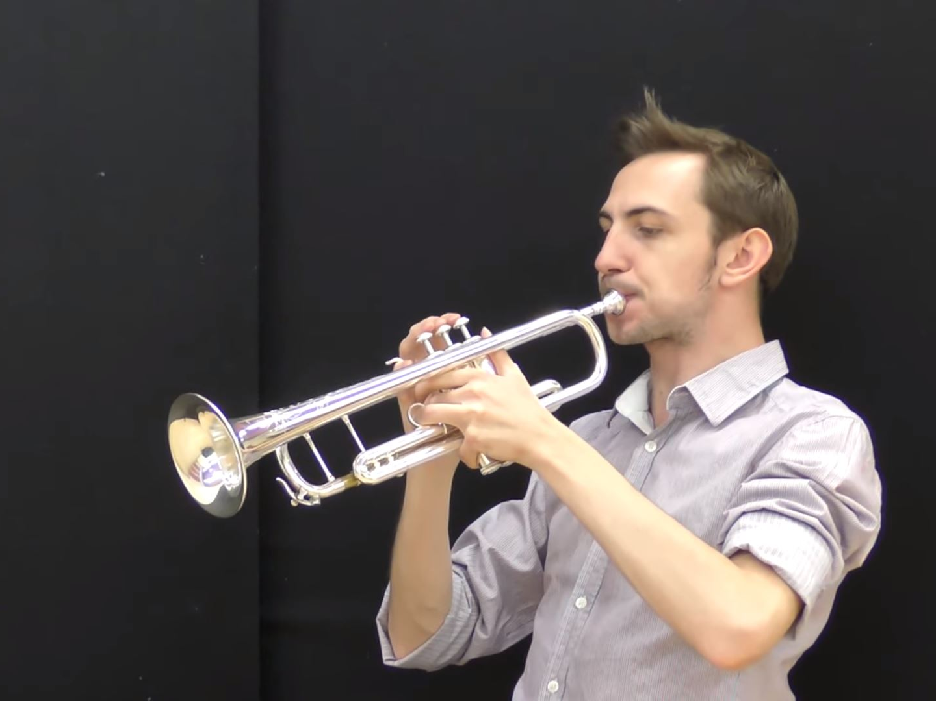
back
Notes:
Teacher Note - Please check that the content in this link/links, including any comments, is suitable for your educational environment before showing. Please do not let the next video automatically play at the end of the clip. Twinkl accepts no responsibility for the content of third party websites. This PowerPoint Presentation/resource contains links to external websites. Please check that the content of external links is appropriate for the intended audience. Twinkl Ltd is not responsible for the content of external links.

Slide 11
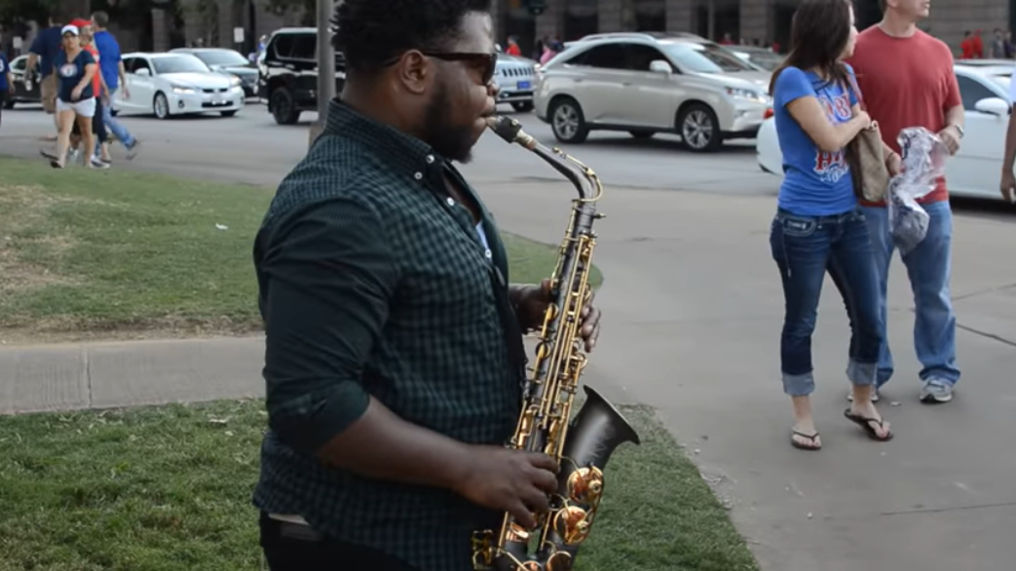
back
Notes:
Teacher Note - Please check that the content in this link/links, including any comments, is suitable for your educational environment before showing. Please do not let the next video automatically play at the end of the clip. Twinkl accepts no responsibility for the content of third party websites. This PowerPoint Presentation/resource contains links to external websites. Please check that the content of external links is appropriate for the intended audience. Twinkl Ltd is not responsible for the content of external links.

Slide 12
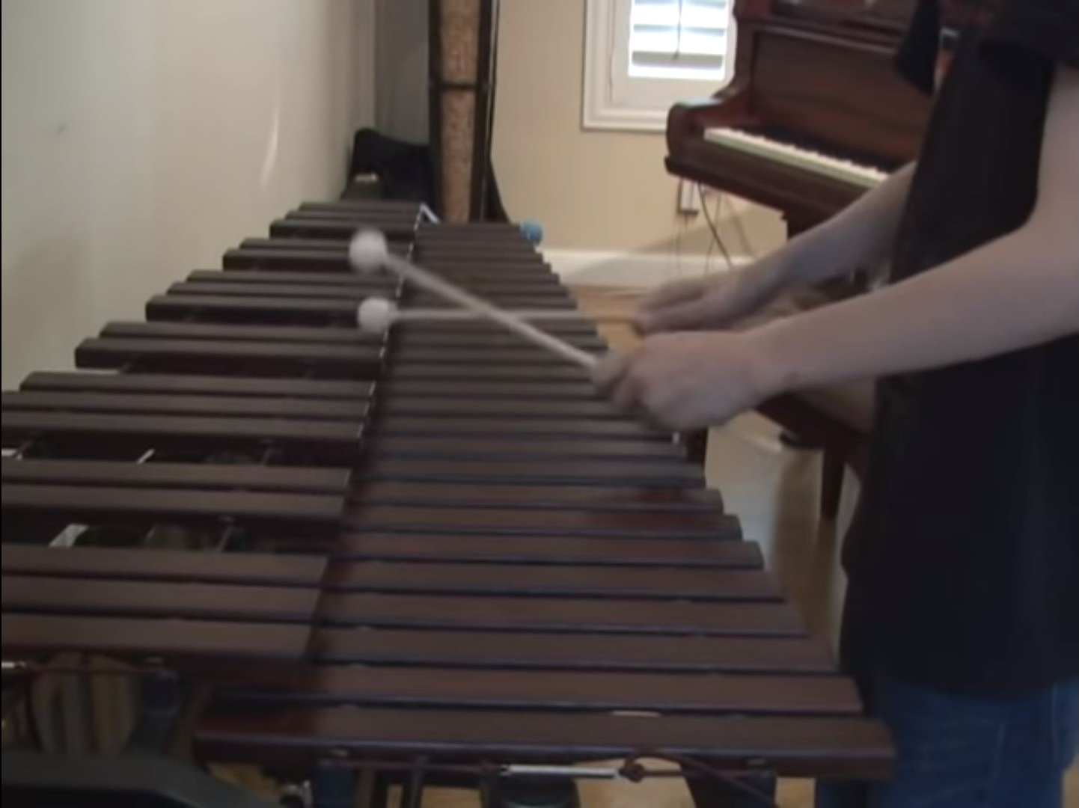
back
Notes:
Teacher Note - Please check that the content in this link/links, including any comments, is suitable for your educational environment before showing. Please do not let the next video automatically play at the end of the clip. Twinkl accepts no responsibility for the content of third party websites. This PowerPoint Presentation/resource contains links to external websites. Please check that the content of external links is appropriate for the intended audience. Twinkl Ltd is not responsible for the content of external links.

Slide 13
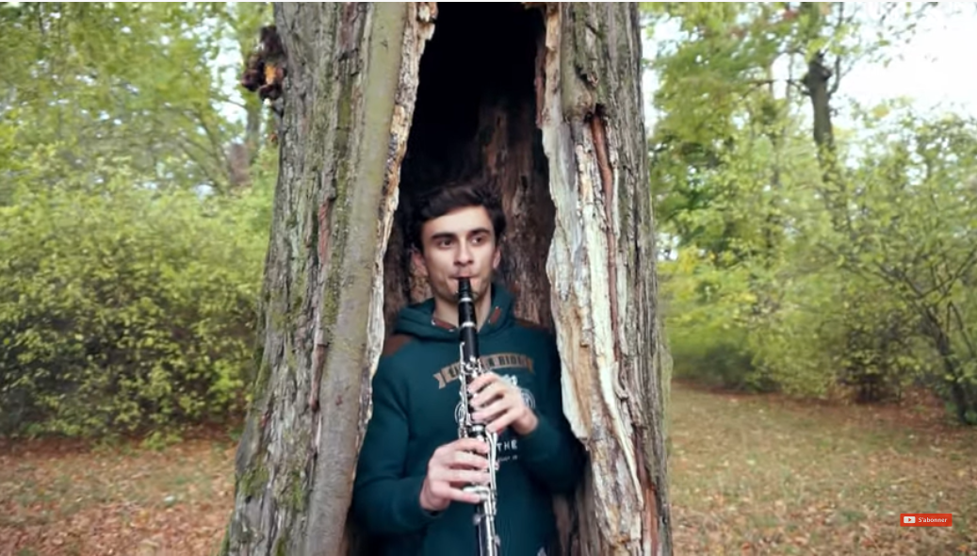
back
Notes:
Teacher Note - Please check that the content in this link/links, including any comments, is suitable for your educational environment before showing. Please do not let the next video automatically play at the end of the clip. Twinkl accepts no responsibility for the content of third party websites. This PowerPoint Presentation/resource contains links to external websites. Please check that the content of external links is appropriate for the intended audience. Twinkl Ltd is not responsible for the content of external links.

Slide 14
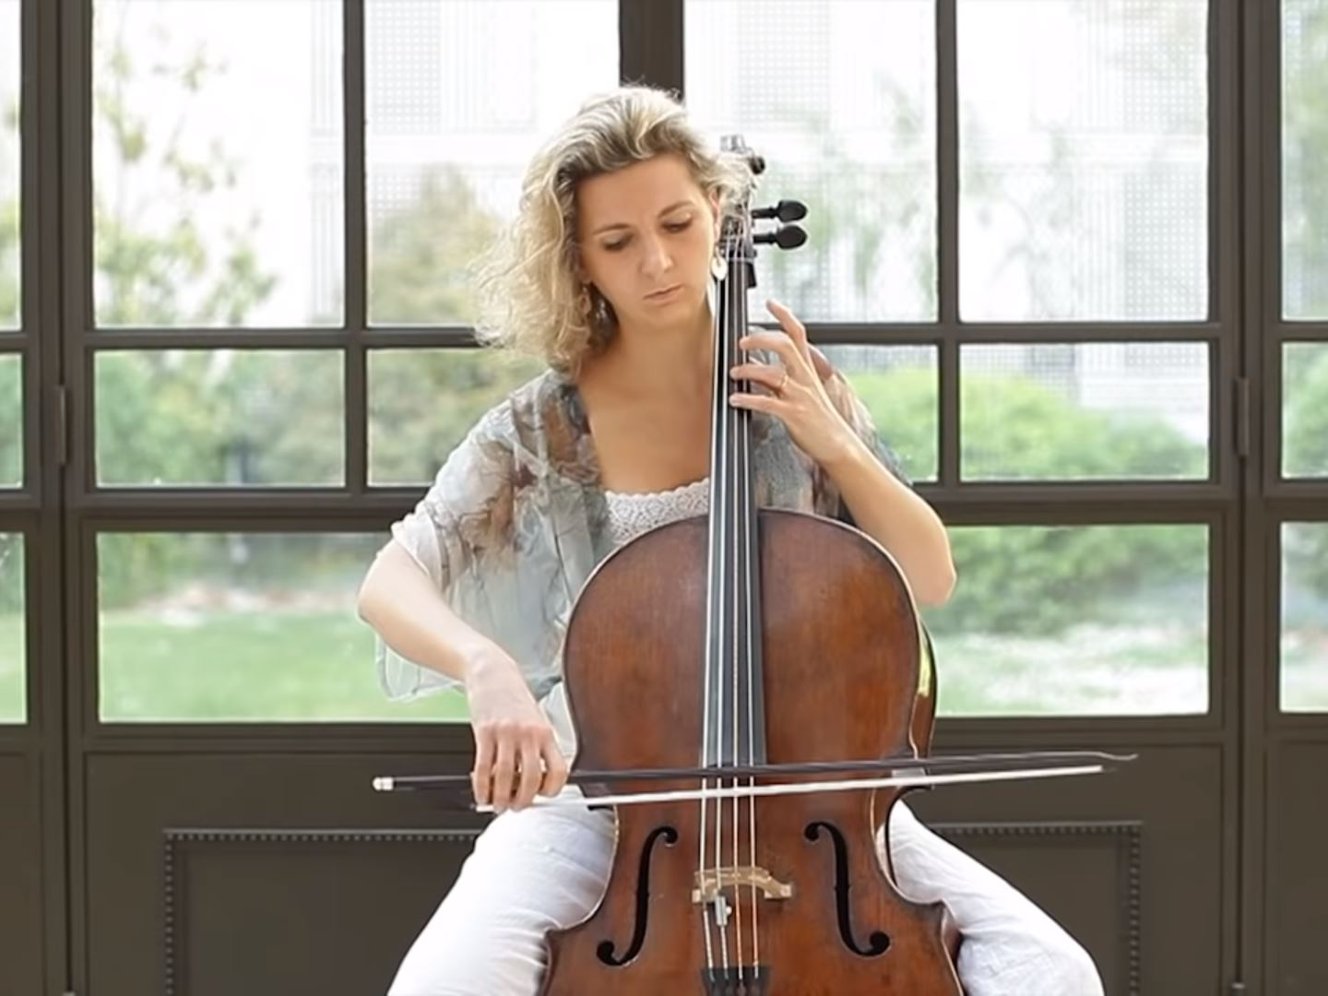
back
Notes:
Teacher Note - Please check that the content in this link/links, including any comments, is suitable for your educational environment before showing. Please do not let the next video automatically play at the end of the clip. Twinkl accepts no responsibility for the content of third party websites. This PowerPoint Presentation/resource contains links to external websites. Please check that the content of external links is appropriate for the intended audience. Twinkl Ltd is not responsible for the content of external links.

Slide 15
What's your favourite musical instrument?
Can you play an instrument?
What type of music do you listen to?
Notes:
Teacher Note - Please check that the content in this link/links, including any comments, is suitable for your educational environment before showing. Please do not let the next video automatically play at the end of the clip. Twinkl accepts no responsibility for the content of third party websites. This PowerPoint Presentation/resource contains links to external websites. Please check that the content of external links is appropriate for the intended audience. Twinkl Ltd is not responsible for the content of external links.

Slide 16
Notes:
Teacher Note - Please check that the content in this link/links, including any comments, is suitable for your educational environment before showing. Please do not let the next video automatically play at the end of the clip. Twinkl accepts no responsibility for the content of third party websites. This PowerPoint Presentation/resource contains links to external websites. Please check that the content of external links is appropriate for the intended audience. Twinkl Ltd is not responsible for the content of external links.

