Slide 1


Slide 2
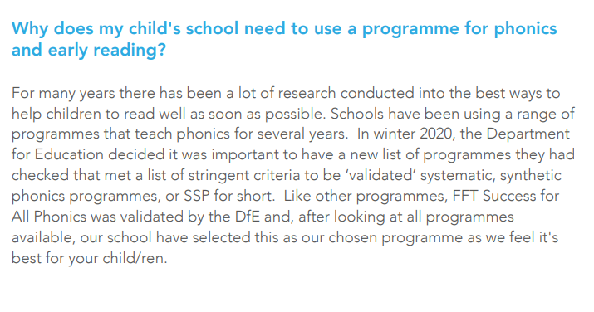

Slide 3
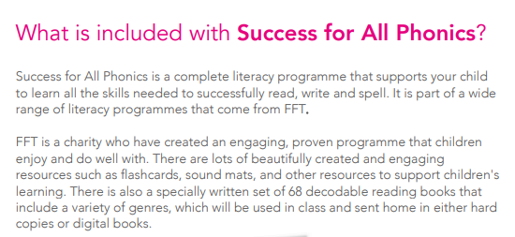

Slide 4
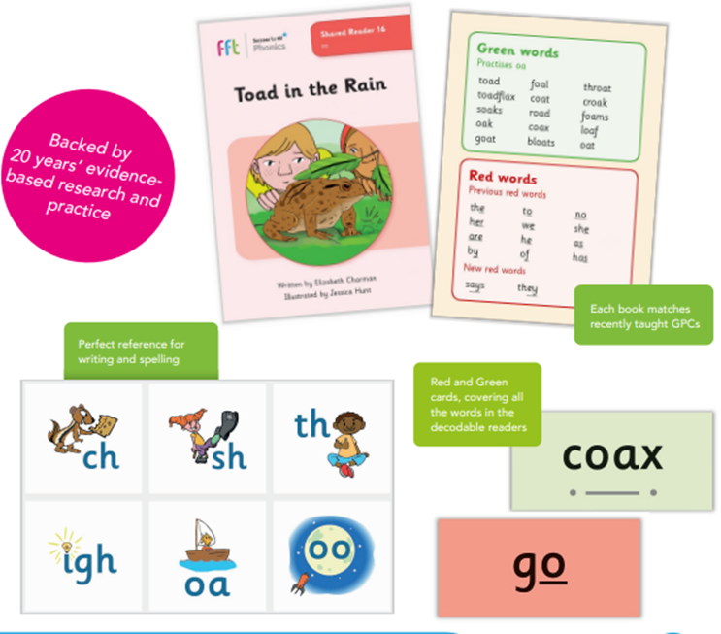

Slide 5
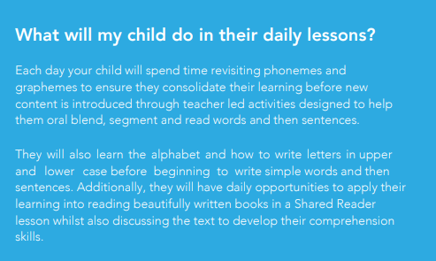

Slide 6
Model phonics lesson format
- Alphabet song
- Initial sounds pictures
Flash card phonemes
Partner practice book
- Stretch and read including red words later in the year
Teach new phoneme
Say it fast
Break it down
Stretch and read
Model writing grapheme
Individual writing- this builds to CVC, CVCC, CCVC words then captions then sentences
Guided reading

Slide 7
Model guided reading format
Questions about the book and title
Red and green words
Choral read Monday
Partner read Tuesday and Wednesday
Expression and fluency and comprehension questions answered in full sentences Thursday
Individual read aloud Friday
Comprehension questions every day including inference and opinion
As year progresses, some writing is added of red words for spelling and some sentence writing to answer comprehension.

Slide 8
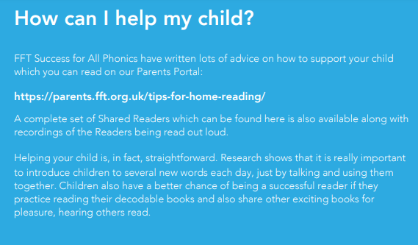
Link to parent portal

Slide 9
Link to parent portal
www.parents.fft.org.uk Password gu2f42
- Have sound mat available when reading and writing
Find the best time to suit your family for reading ideally daily. This need only be 5 mins to begin with and can extend as your child’s focus improves.
If they are struggling try choral read- my turn, your turn and encourage child pointing to words as they read.
Reading for pleasure- I read, we read, you read books.
Record on Boom reader so we have record of how home reading is progressing.

Slide 10


